Slide 1
About me: Steve Waterman, K4CJX
Been a Ham since 1955, CW (mostly) until 1986
In 1986, at Dayton Hamvention, met Vic Poor, W5SMM, Co-Author of the single chip microprocessor, and author of ApLink & later, Winlink.
Involved with digital data transfer/EmComm ever since.
Take a look at: https://winlink.org/content/last_voice_Kuwait)
Currently:
BOD, ARSFI & Winlink Administrator for the WDT
CISA SHARES Winlink Admin & Chair, Winlink & RMS SYSOPS Working Groups.
MEMBER OF FEMA R IV, V, X RECCWG AuxComm Working Groups & Chair FEMA R IV AuxComm Working Group.
TEMA COMU
Williamson County, TN EMA Reserves

Slide 2
Relying on normal Public Safety communications systems that requires a local infrastructure
It happens all the time!
can lead to issues in certain situations, especially for complex message transfer.

Slide 3
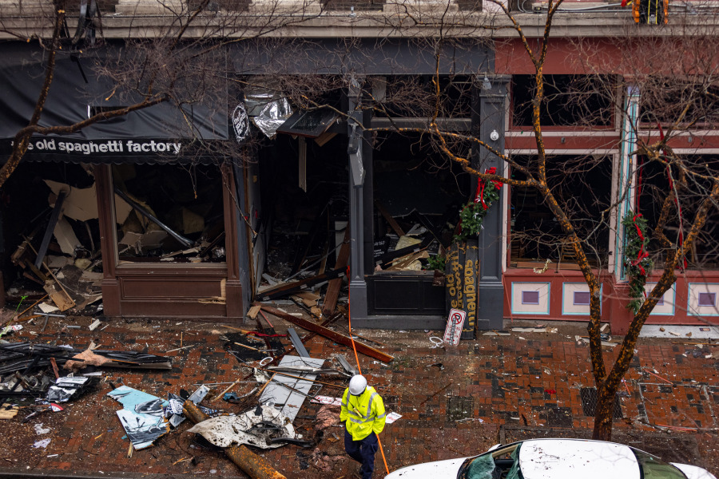
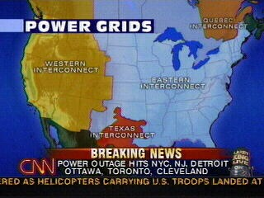
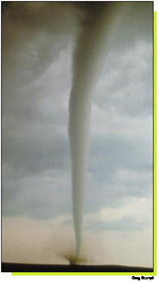
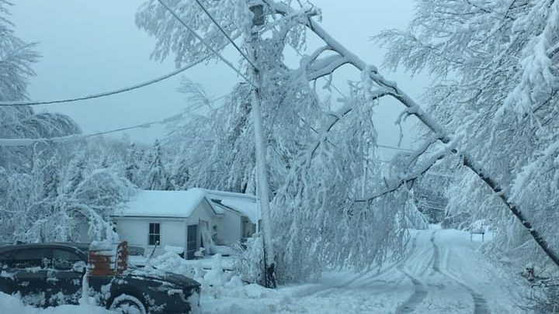
We cannot predict the size, nature or location of disaster areas! We be must prepared, regardless.
Local?
Regional?
National?
Nashville bombing
Worldwide?
3

Slide 4
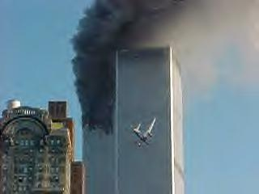
We can’t predict the size, nature or location of a disaster area! We must be prepared, regardless.
Local?
Regional?
National?
Global?
4

Slide 5
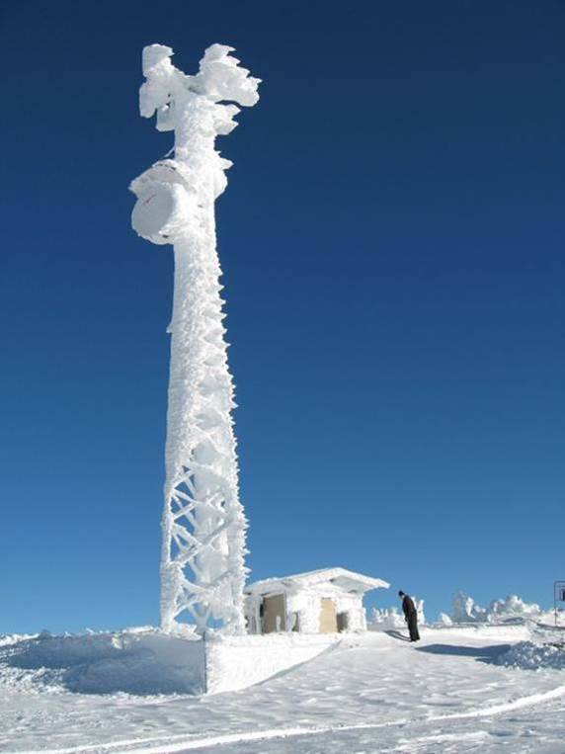
We can’t predict the size, nature or location of a disaster area! We be must prepared, regardless.
Local?
Regional?
National?
Global?
5

Slide 6
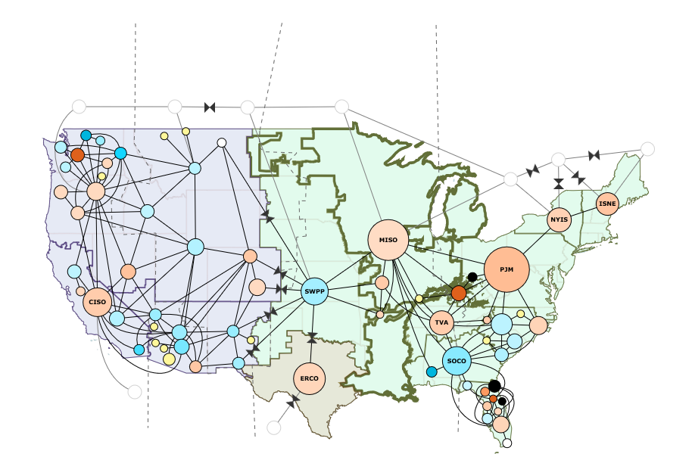
Network Restoration
How do you coordinate any large network restoration without “normal” communications?
Power Grid? Internet? land lines? cell phones? satellite phones? LMR networks? They all depend on vulnerable infrastructure which depend on power, water, fuel, people.
Graphic by U. S. Energy Information Administration

Slide 7
Why should this matter to HAMS?
The first statement in the FCC Part 97 Amateur Regulations:
FCC Part §97.1 Basis and purpose: (a) Recognition and enhancement of the value of the amateur service to the public as a voluntary noncommercial communication service, particularly with respect to providing emergency communications.

Slide 8
Amateur Radio EmComm: A double edged sword?
FCC says EmComm is a critically important justification for the existence of the Amateur Service…
BUT….there are…
Severe regulatory restrictions in Part 97 (mainly due to Historical Lobbying efforts ie: (§ 97.113)
Limited spectrum and no channelization.
Data transfer restrictions (symbol rate rule)
No specific EmComm training required in Part 97 (no mention of NIMS ICS)
FCC states that we are a “Public Service” not an “Emergency Service.” Does that diminish our value?

Slide 9
Should we feel threatened?
A recent example: “FCC Formally Adopts Proposals to Remove Amateur 3-GHz Band” 12/17/2019
A NPRM comes in response to the MOBILE NOW Act [Making Opportunities for Broadband Investment and Limiting “Excessive and Needless” Obstacles to Wireless], approved by the 115th Congress to make available new spectrum for mobile and fixed wireless broadband use.”
http://www.arrl.org/news/fcc-formally-adopts-proposals-to-remove-amateur-3-ghz-band-invites-comments

Slide 10
Should we feel threatened?
US Department of Defense to Share 3450 – 3550 MHz with 5G Commercial Operations
08/12/2020
http://www.arrl.org/news/us-department-of-defense-to-share-3450-3550-mhz-with-5g-commercial-operations

Slide 11
Another example: a potential threat?
Spread Spectrum: “provide secure communications by spreading the signal over a large frequency band. ”

Slide 12
Main Problem: Indifference
Bill Cross, FCC Amateur division, retired on April 1, 2015. He has never been replaced.
http://www.arrl.org/news/the-fcc-s-ham-guy-bill-cross-w3tn-to-retire-on-april-3
Requests to the FCC from various sources on all sides of any pertinent Amateur issue seem to remain in limbo.
99% of US Amateur Radio population does not bother to get involved with FCC issues. Few bother to formally comment on issues pertaining to Amateur Radio when asked.
Most of us do care, but we do not participate. Is our complacency related to our overall average age? “10 years from now, what will be so, so what…”

Slide 13
A final example
§ 97.113 Prohibited transmissions.
(a) No amateur station shall transmit:
(5) Communications, on a regular basis, which could reasonably be furnished alternatively through other radio services.

Slide 14
Recent Statement from WTB
FCC WTB: “While the value of the amateur service to the public as a voluntary noncommercial communications service, particularly with respect to providing emergency communications, is one of the underlying principles of the amateur service, the amateur service is not an emergency radio service.“
So, as HAMS interested in EmComm, how can we optimize our value to our communities?

Slide 15
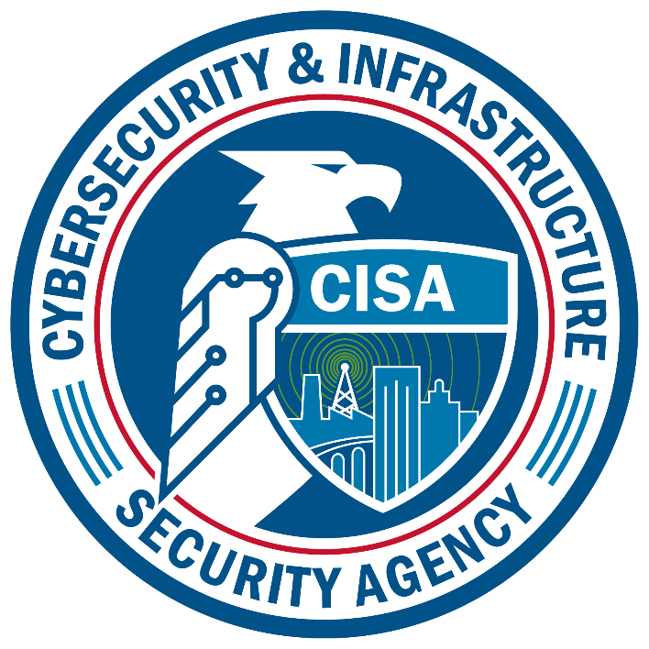
The SHAred RESources High Frequency Radio Program
Making a difference: Our Best option
07/16/2020
How to make a significant impact toward securing our survival…while providing optimal volunteer services to our communities.

Slide 16
The SHARES Opportunity
Under former National Communications System (NCS), SHARES was a Cold War Warning System for federal government only.
SHARES is now under the new Cybersecurity and Infrastructure Security Agency (CISA),
“the Nation’s risk advisor, working with partners to defend against today’s threats and collaborating to build a more secure and resilient infrastructure for the future.”
Now under CISA, SHARES is an All-Hazards Contingency Emergency Communications option for all levels of Civil authorities & their NGO Critical Infrastructure partners.

Slide 17
The SHARES Opportunity
Opportunities for member agencies:
Negligible cost, proven option, attracts knowledgeable volunteer resources (HAMS), all under agency control.
Opportunities for The Amateur Radio volunteer:
what are the opportunities the government provides?
How do we approach these opportunities?
What are the benefits?
How to get started?

Slide 18
CISA SHARES IS NOT HAM RADIO
CISA SHARES is a service for member agencies
at all levels of government
NGO Critical infrastructure partners.
Member agencies are strongly encouraged to use Amateur Radio volunteers. Most SHARES operational & “on-air” activities are from volunteer resources (HAMS).
ESF2 professionals are usually not HF savvy. Those that are, have no time to spare.
HF Communications expertise and knowledge of NIMS brings Amateur Radio to the table.
It’s all about building relationships with those AHJ’s and their NGO partners.

Slide 19
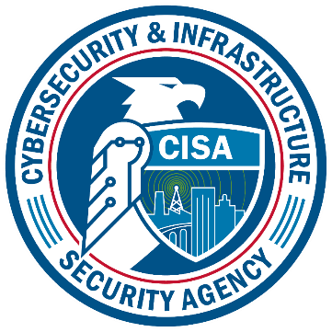
Where is SHARES?
Department of Homeland Security (DHS) Cybersecurity and Infrastructure Security Agency (CISA) Emergency Response Operations (ERO) National Coordinating Center for Communications (NCC) The SHAred RESources (SHARES) Radio program

Slide 20
SHARES: Mission & Purpose
The purpose of SHARES is to support interoperable emergency communications by radio for national security and emergency preparedness.
The SHARES mission is to support the mission of its member agencies.

Slide 21
Why SHARES?
“SHARED” RESOURCES: – Approximately 2800+ participants.
Multiple agencies’ (“share” resources)
Example: Frequencies
SHARES - 141 HF channels
Other federal agency channels - 218 HF channels,
SHARES Winlink - 110 specific dedicated HF channels & 2 VHF channels, (more pending).

Slide 22
Why SHARES?
Proven components: SSB Voice & Winlink radio email, all on “exclusive” federal channels. (Also, ALE “voice,” HF/LF Alert beacons, etc.)
A true emergency service that promotes volunteer participation.
No FCC Part 90 Type Acceptance hardware restrictions for Agencies (no FCC).
(may use opened Ham equipment. Much less expensive, more flexible)
Requires no external communications infrastructure & costs are minimal.
Interoperable among civil authorities and their NGO partners.

Slide 23
Why SHARES?
What Can SHARES do that Ham EMCOMM can’t?
Encryption
Faster data – no symbol rate limit
Agency personnel can operate radio – no gap in comms waiting for volunteer to arrive
For the EmComm-trained Amateur Radio volunteer, what can SHARES provide in addition to that provided on the Amateur Spectrum?
Okay to “obscure” the meaning of content (Encryption, password protected documents)– § 97.113(a)(4)*
Faster data – no antiquated symbol rate limit! - § 97.307(f)(3)*
Agency personnel allowed to operate radios – no gap in comms waiting for licensed ham volunteers to arrive.
No pecuniary interest rule - § 97.113(a)(3)*
“Exclusive-use” HF NTIA channelization*
Much expanded HF spectrum - less propagation issues.
Direct Interoperability with other communications resources*.
* Not permitted on the Amateur Spectrum.

Slide 24
Interoperability is paramount
For complete interoperability, stations participating in SHARES may communicate with:
Civil authorities at all Levels of Government.
Federal, state, local
Critical Infrastructure providers, including telecommunications, power, common carriers, hospitals, medevac coordinators, transportation and more.
National/regional disaster relief organizations.
National/State Guards
(More)

Slide 25
Interoperability Continued
For complete interoperability, stations participating in SHARES may communicate with:
Amateurs using the five secondary 5 MHz channels.
Internet gateway between the SHARES Hybrid Winlink Network and Amateur Radio Winlink.
The Integrated Public Alert & Warning System (FEMA IPAWS)
Non-US stations for disaster response coordination.

Slide 26
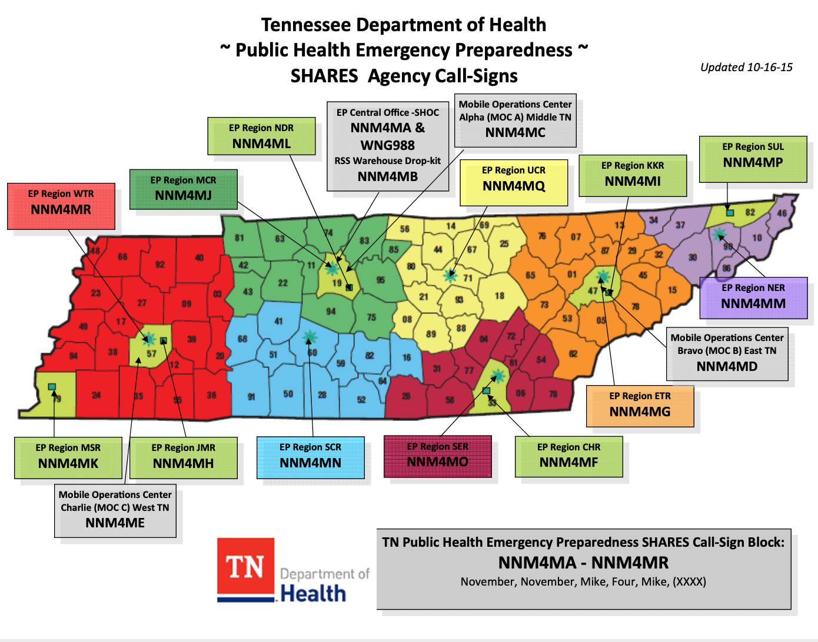
TDOH (Example)

Slide 27
TN National Guard (Example)

Slide 28
Role of the Member Agency
Register stations & responsible personnel
SHARES can help obtain station call signs for agencies.
Participate – keep equipment ready & operators trained
(again, opportunity for volunteer resources – (HAMS)!
Coordinate and manage qualified volunteers – (HAMS)!
Fund equipment (The price is right)!
Cost per station is much less than a single P25 handheld if modified ham equipment is used. NTIA allows and volunteers know how to use (Many hams already have equipment for such use.)

Slide 29
The Role of the Volunteer
Volunteers are managed by their member agency.
Volunteers may be used to operate SHARES stations, freeing agency staff to do work that can’t be done by volunteers.
License is not required (Ham license highly recommended).
Member agency is responsible for determining qualifications of who uses their SHARES station call signs. No operator licenses; only station licenses.
Agencies usually require NIMS training - online, classroom.

Slide 30
Importance of the Volunteer Role
The value of volunteer amateur operators cannot be overstated. DHS comments filed to the FCC regarding the use of amateur volunteers during the 2017 Hurricane season (mainly Maria):
“FCC Q1: To what extent were response efforts facilitated by amateur radio operators?
DHS A1: In addition to the direct services provided by amateur radio operators, the indirect services of technology development, operator training, and support of the SHARES Winlink network (among others) makes amateur radio an indispensable component of our national capability to prepare for, protect against, respond to, recover from, and mitigate against all hazards.”

Slide 31
Importance of the Volunteer Role
The value of volunteer amateur operators cannot be overstated. DHS comments filed to the FCC regarding the use of amateur volunteers during the 2017 Hurricane season (mainly Maria):
“FCC Q2: Going forward, should efforts be made to increase the use of amateur radio services in connection with the planning, testing and provision of emergency response and recovery communications?
DHS A2: We ask the Commission to review those aspects of Part 97 of their rules relating to emergency communications, including operational and technical restrictions, which limit utilization of new technologies”.

Slide 32
More About the Volunteer Role
For qualified volunteers with the needed skill sets, it’s all about building relationships with your nearby agencies, and then following appropriate organizational management. (the “Golden Rule”)
“First of all, I'll state my premise for volunteer usage in the State EOC. It is simply that anyone, regardless of affiliation, professional or volunteer, who works in the SEOC during an emergency, works for us. Their parent organization has no operational control once they set foot in the Ops center. The parent organization has the responsibility to train and provide communications personnel to the agency. That is where their job ends. They are a functional unit, and do not command operationally in any manner. This avoids any ambiguity in the chain of command.”
Hank Koebler, Chief, Operations (Ret), Tennessee Emergency Management Agency (Currently, DHS/CISA COMU Instructor/ICTAP SME)

Slide 33
More About the Volunteer Role
Mike Harris, Communications Manager for TEMA, adds this:
“Please leave your Ham badges, Ham T-Shirts, Ham volunteer organizational hierarchy, and Ham jargon at the door, and enter with your current skill sets, and a willingness to listen and learn.”

Slide 34
SHARES Services: Summary
Scheduled weekly SSB voice / digital Nets.
ALE (voice) Nets, CUSEC net
The DHS Winlink Hybrid Radio Email Network
HF Alerting / LF Alerting
Collaboration (various working groups) Monthly, by Webinar
Interoperability working group (IWG)
Combined Programs working groups (CWG)
Winlink RMS SYSOPS working group

Slide 35
Voice Nets (Agencies & their volunteers)
Weekly Radio “Tests,” Every Wednesday
National Net | 1100-1300 EST/EDT
Southeast Region Net | 1100-1200 EST/EDT
All Other SHARES Regions | 1200-1300 EST/EDT
SHARES West (Pacific & Western States) | 1300-1330 EST/EDT
CW | 1200-1230 EST / 1300-1330 EDT
Northeast Region - Evening | 1900-2000 EST/EDT
Idaho | 1115-1145 EST/EDT
Other Weekly Radio Tests
CUSEC | Tuesday 1400-1440 EST/EDT
North Region – Evening – Voice & Data | Daily 1900-2000 EST/EDT
California | Tuesday 1600-1700 EST/EDT
SHARES West | 1300-1330 EST/EDT
Automatic Link establishment (ALE) | Continuous

Slide 36
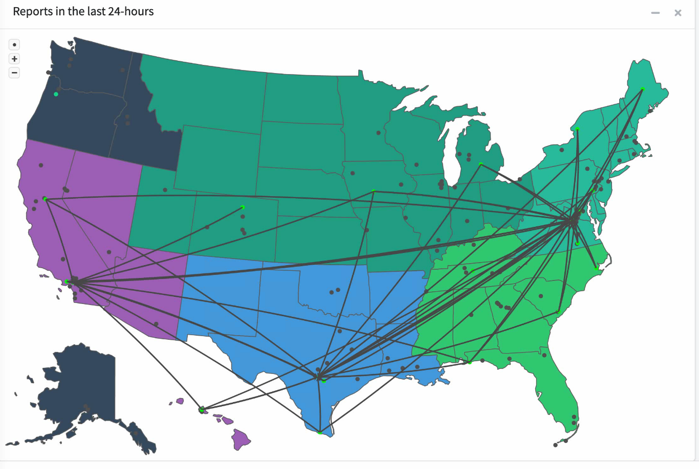
SHARES ALE
?

Slide 37
Example: SHARES Winlink
A true Hybrid Network
DHS “normal” Winlink hosts over 95 RMS Gateways that receive traffic from end-users (growing rapidly)
Standard Winlink bridging to the Internet with RF.
Unique “Radio Only” without the use of the Internet
Each RMS scans five channels every 16 seconds.
Up 24x7 with fault notification for down time.
(Mostly) Volunteer resources (HAMS) provide no-cost maintenance for agencies with Winlink systems.
Available to any SHARES member and their designated volunteers 24 x 7 x 365.

Slide 38
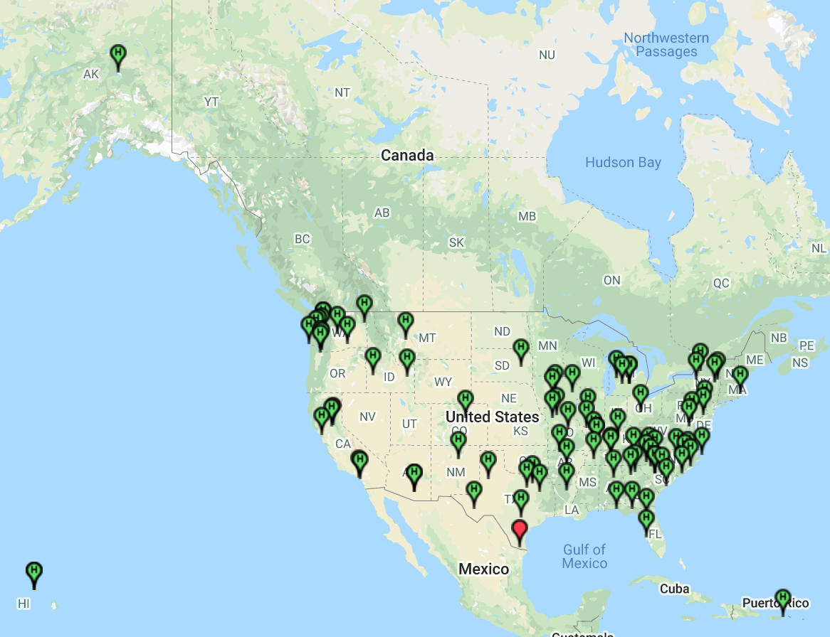
SHARES Winlink RMS Gateways
FSM 1 RMS
Gateway
HI: 2 RMS Gateways
PR: 2 RMS Gateways

Slide 39
Tendency to take out an RMS

Slide 40
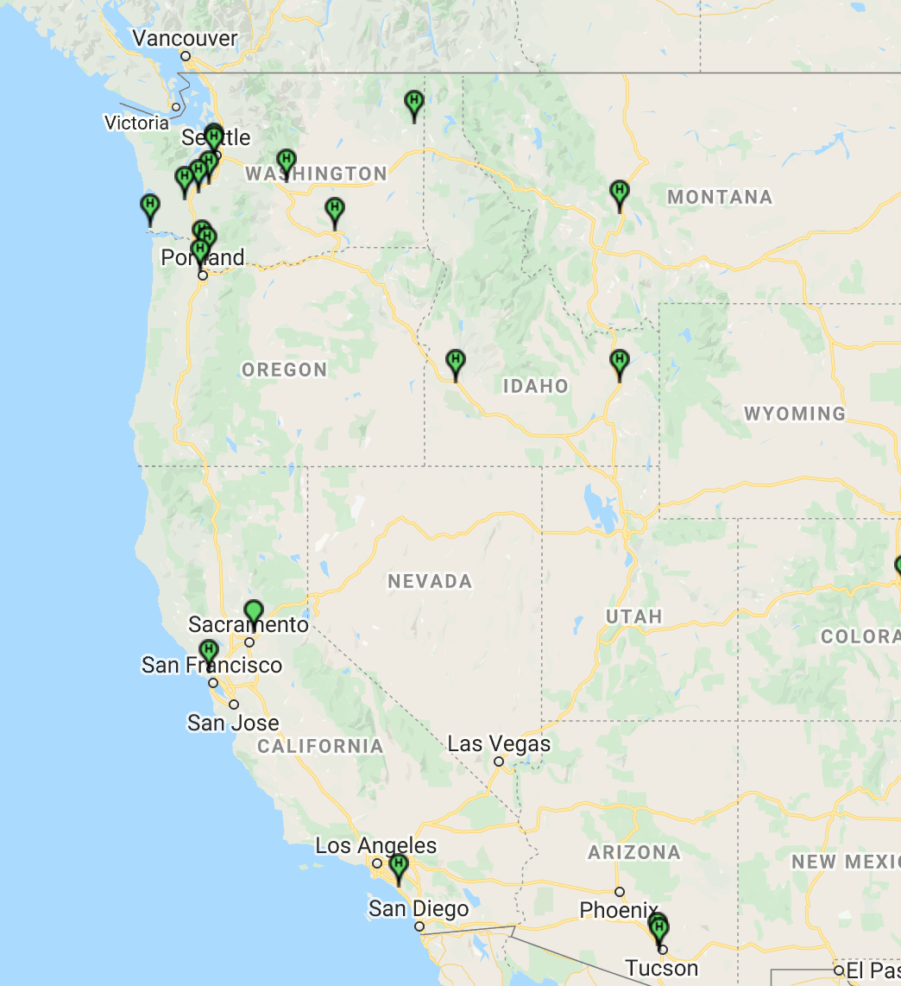
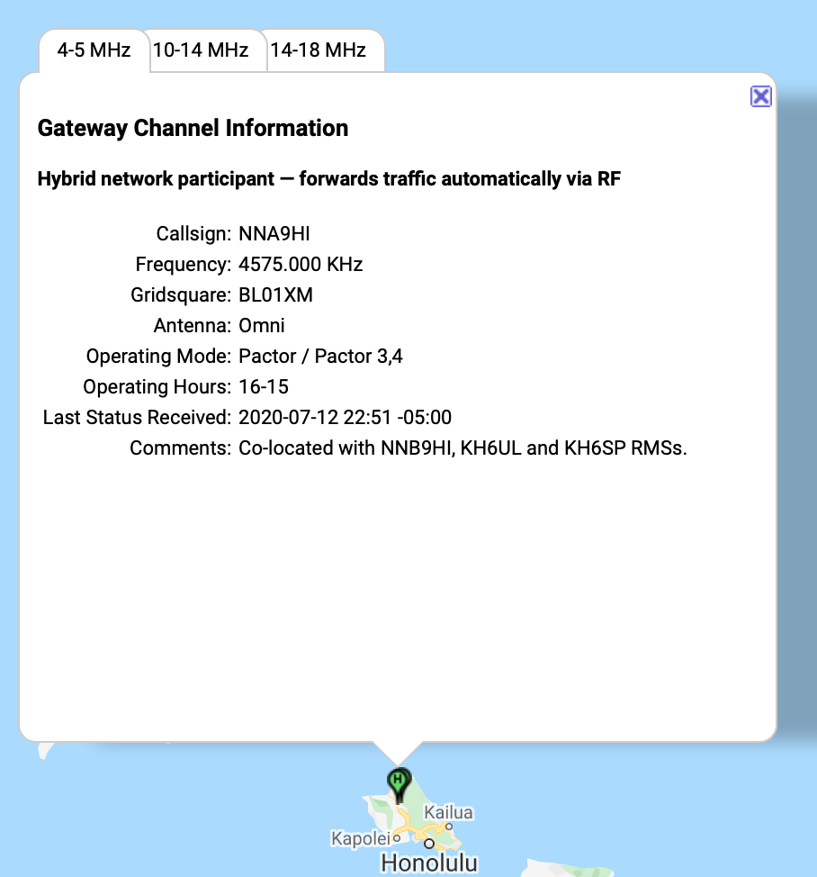
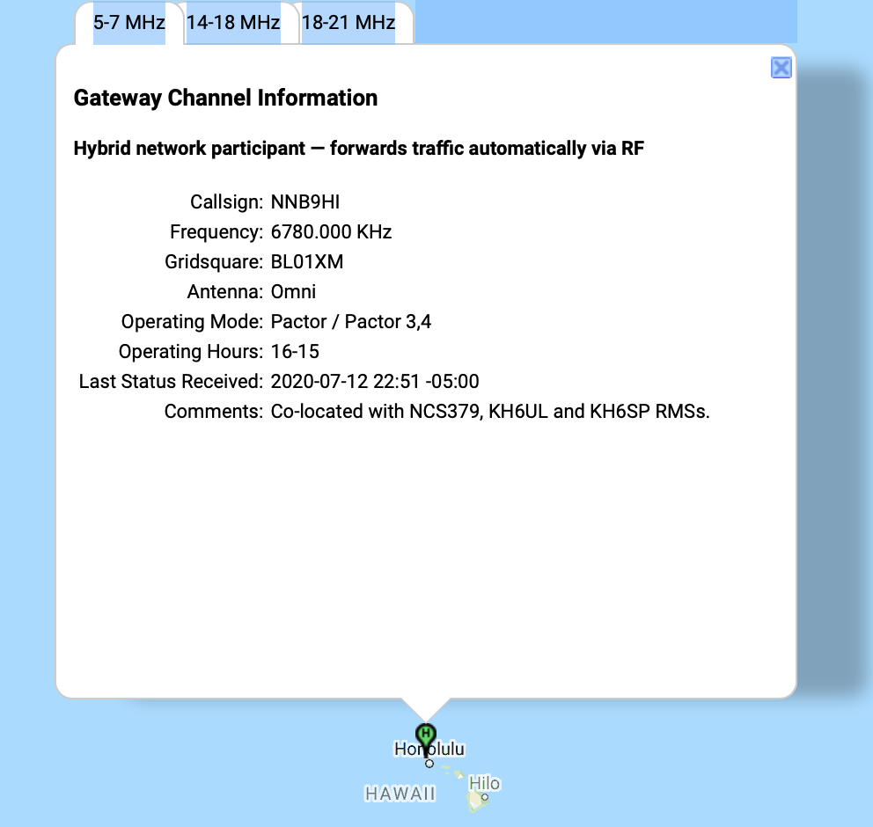
What’s current for the NW?

Slide 41
“Bottom of the barrel”

Slide 42
The SHARES advantage (Example)
From Nashville, TN to Oahu, HI. (June 3, 2020, 02:39 UTC on 14.8 MHz
TN = 100 watts, 130 foot end fed, 30 feet high.
HI = 100 Watts, Vertical Log Periodic, 600 Ft long, 140 feet high

Slide 43
SHARES RMS: NNA9HI & NNB9HI OAHU, HI
TCI-507 quad rosette antenna
Cross shaped. Each leg from center is 300 ft. long, 140 ft high
4 vertical log periodic arrays with gain at approximately 13 db.
Noise floor -130 dbm (“none”) Covers 9 acres.

Slide 44
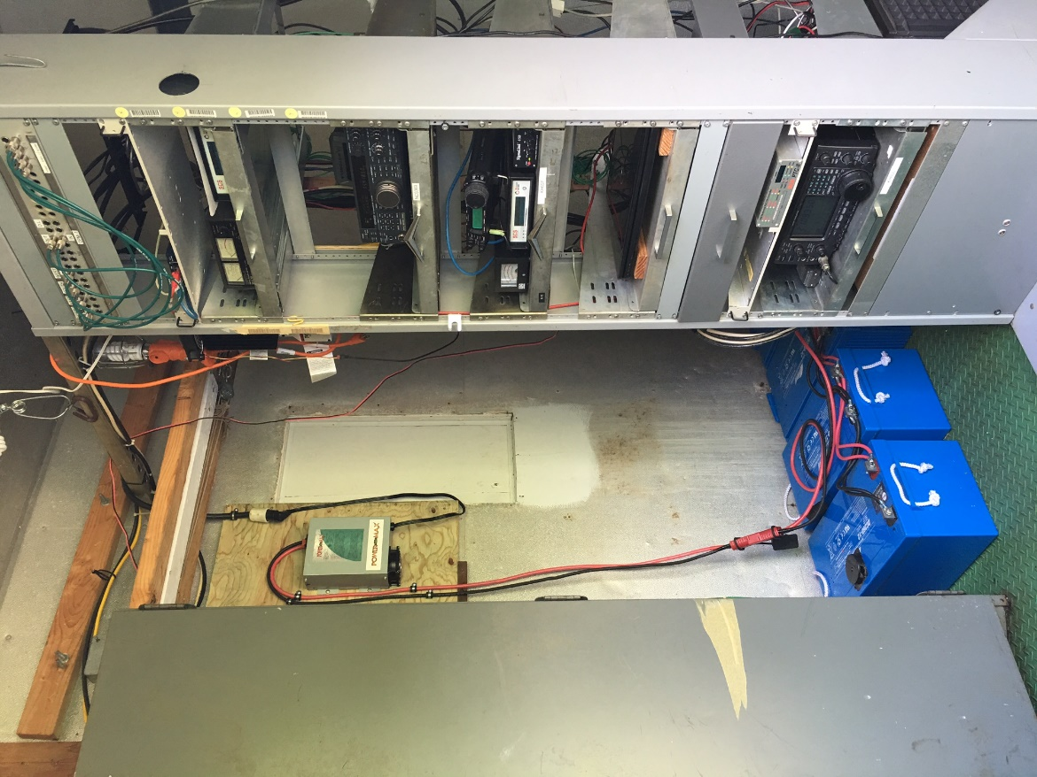
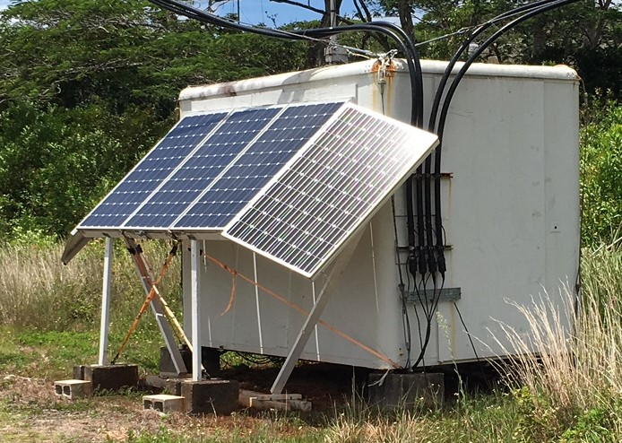
SHARES RMS: NNA9HI & NNB9HI OAHU, HI

Slide 45
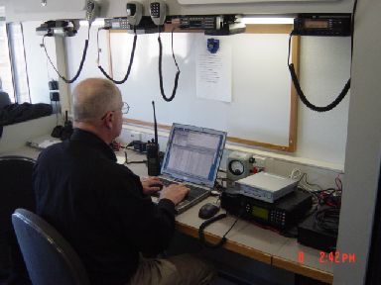
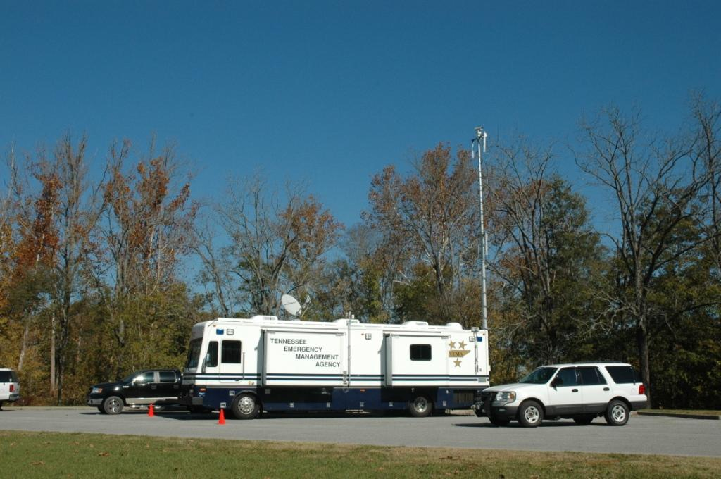
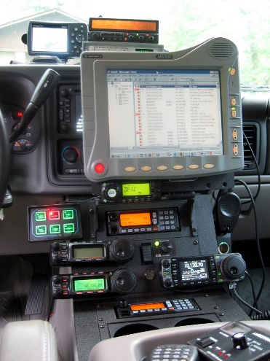
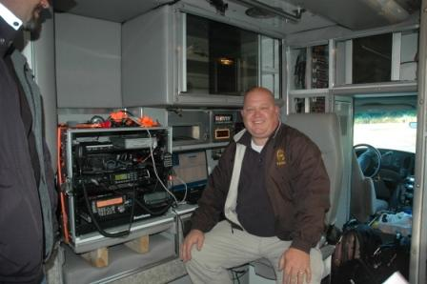
The ability to provide e-mail where summoned, and without local communications infrastructure, does not occur often but when it does, this is a cost effective proven solution. ( Example)
TN EMA (TEMA)
TEMA
Williamson County EMA

Slide 46
Winlink Nationwide HF Email Network for Emergency Response
Cell, Land-line? NO!
Satellite/Microwave? NO!
VHF/UHF/800/700 Public Safety Service, NO!
Mobile HF SSB? YES
Mobile Winlink Radio E-Mail?
You are looking at the results of one of many pix sent by non-Ham Winlink during TEMA recon to KY during an ice storm.

Slide 47
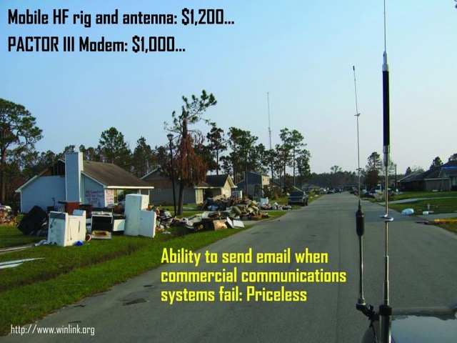
The SHARES Alternative (Winlink)
HF mobile radio & Antenna: $1,400
Pactor 4 modem: $1,400

Slide 48
Questions?
Cybersecurity and Infrastructure Security Agency
SHARES HF Radio Program
703-235-5329
nccshares@hq.dhs.gov
www.dhs.gov/shares
Ross Merlin, WA2WDT
SHARES Program Manager
Office 703-235-5758
Cell 202-631-0690
ross.merlin@cisa.dhs.gov
Steve Waterman, K4CJX DHS CISA SHARES (Winlink Admin)
Cell: 615-300-5296 k4cjx@comcast.net

